Slide 1
NZGA Webinar Streetscapes that optimise age-friendly participation: Collaborative insights
26 September 2024
by
Vivian Naylor, Barrier Free Advisor & Educator
CCS Disability Action

Slide 2
Accessible (and safe) journeys
For ALL ages and stages in life
Dependent upon:
Personal mobility modes
The design of pavements & intersections
Public transport modes
Designing to overcome topography
Getting into and through buildings

Slide 3
Personal mobility modes
Great range of personal mobility models being developed catering
for all ages and abilities

Slide 4
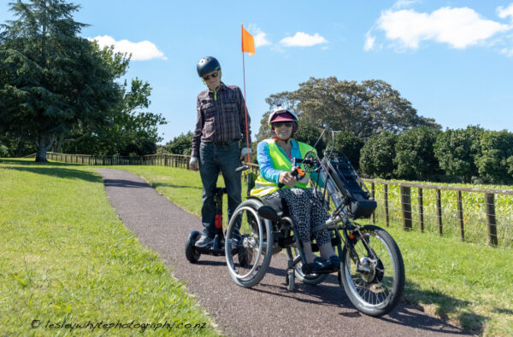
Notes:
83yo husband uses the Segway, pictured and has an e-scooter. Age is no barrier!
I am on my handcycle which is simply a remodelling of e-bike parts.

Slide 5
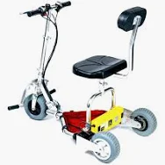
Example of TravelScoot model
Notes:
TravelScoots are popular with cruise ship passengers, but they have a narrow wheelbase and even a slight sudden and unexpected change in pavement transverse gradient can cause the unit to tip, especially if the user is tall giving a high centre of gravity.
Also range of e-scooters, now with seats and one model currently has two front wheels, increasing their stability. Another option for people of any age who have mobility or stamina difficulties.

Slide 6
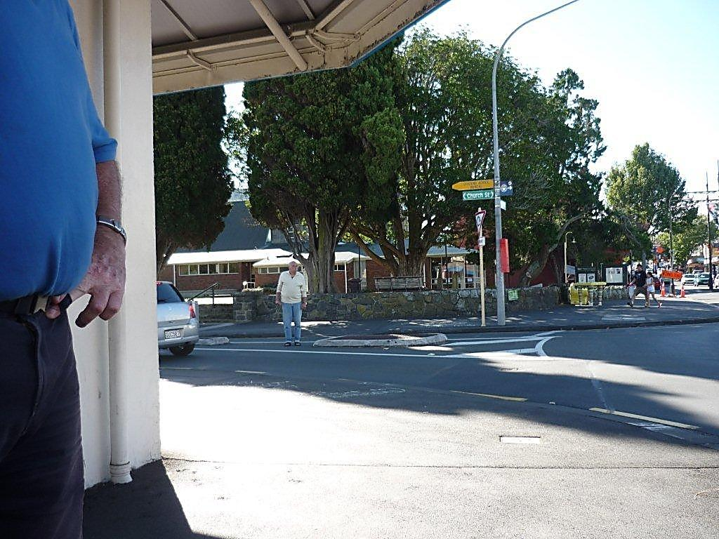
Roundabouts
Design for vulnerable pedestrians
and you design for everyone
Notes:
Elderly man waited for some minutes at this roundabout intersection before he felt he could safely cross. He was even tooted at by one motorist telling him not to cross her path. Motorists have right of way, pedestrians take pot luck…..

Slide 7
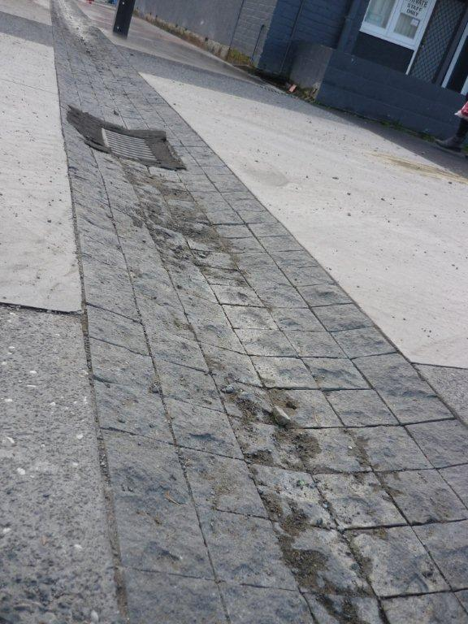
Unexpected hazard across pavement
Notes:
Despite the Accessibility group’s involvement in the redesign of this street, unbeknownst to us at the last minute an engineer installed this drainage channel which cuts right across the footpath. Rough-sawn cobbles line the channel adding to the initial unexpected hazard.

Slide 8
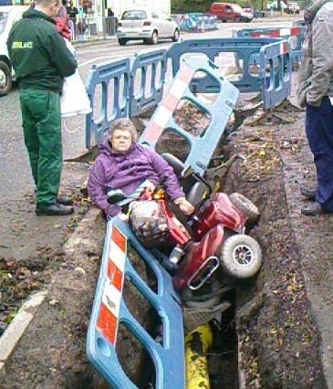
Notes:
Pedestrian needs are not always catered for when road/pavement repairs or modifications are in progress. There have been some deaths in NZ when mobility scooters have needed to divert from the main route due to an inadequate and safe alternative.

Slide 9
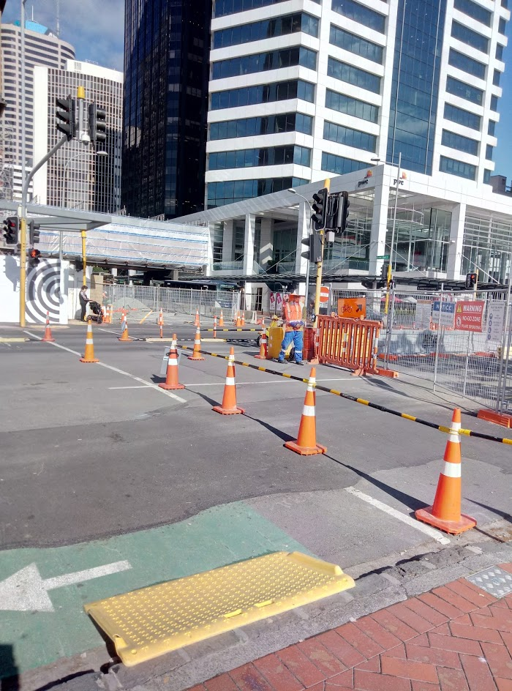
Notes:
This temporary ramp is made of a pliable plastic which deformed when I took my wheelchair over it causing me to tip out of the chair and sustain a broken leg. A totally unsuitable product in this environment. Fortunately, because of my involvement with Auckland Transport I could initiate an appropriate process with key people involved and a directive was sent to roading contractors not to use the product in these circumstances. Now, all the staff involved in this incident have left AT and there is no guarantee that this directive is still in action.

Slide 10
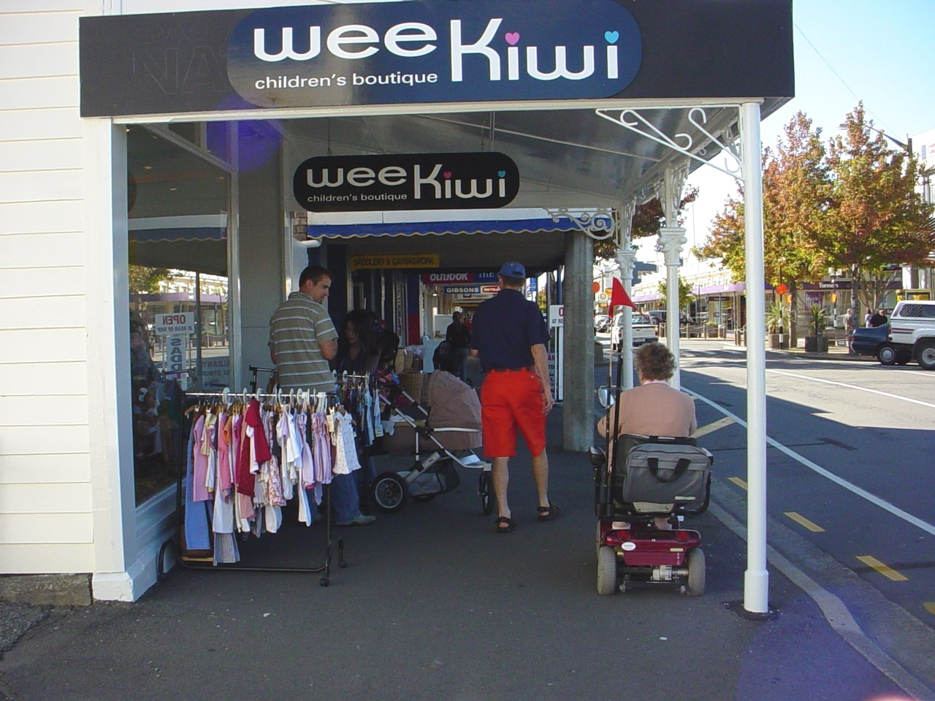
Objects both fixed and moveable block the footpath
Notes:
Disadvantage blind, mobility impaired pedestrians and people with prams

Slide 11
Working with Council’s decision makers and planners
In Auckland via:
Council Advisory Panels – Senior Citizens, Disability
Urban Design Panel
Universal Design Forum
Auckland Transport: Public Transport &
Capital Projects Accessibility Groups

Slide 12
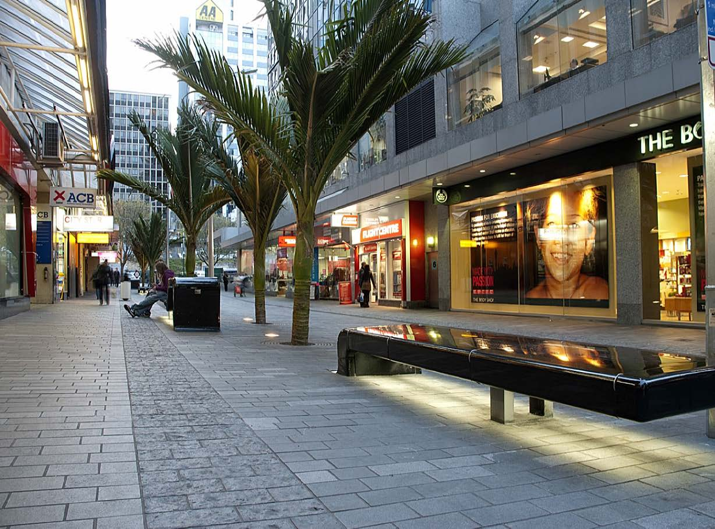
Notes:
Shared space design – Darby Street
If the city has a lot of shared spaces and you cannot drive, park close by and walk the distances, some areas will be out of reach in the future.
The separate, darker pavers on the left-hand side is a tactile indicator. Council went to great trouble to trial different types of pavers, which would be detected by blind people, the primary group, past Accessibility Advisors, but also did not impact negatively on users of mobility equipment.
Unfortunately, the delineator was later interrupted by the subsequent addition of street furniture……

Slide 13
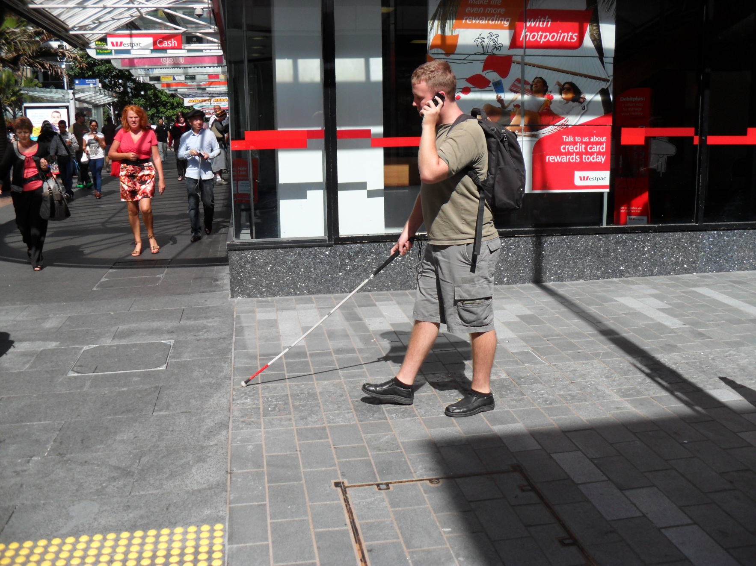
Notes:
Blind man confidently navigating with the tactile delineator down Darby Street, even using a cell phone at the same time!

Slide 14
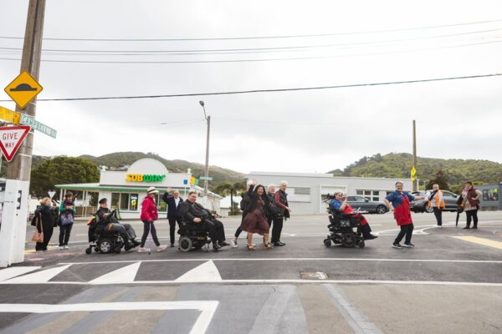
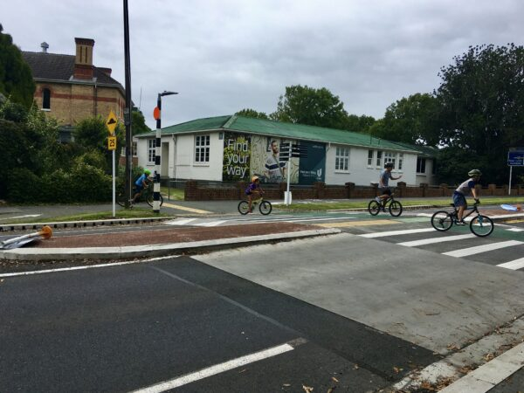
Raised platform crossings
Notes:
Raised platform crossings offer huge advantages for many pedestrians – shorter people including children and wheelchair users because they are more visible to motorists. They are quicker to cross because pedestrians don’t need to navigate often badly designed curb ramps/pram crossings
1st image – residents of a nearby retirement village in the Wellington region celebrate the completion of a valued raised crossing
2nd image – well used raised crossing in an Auckland suburb

Slide 15
Public transport modes
Designing inclusively results in greater patronage

Slide 16
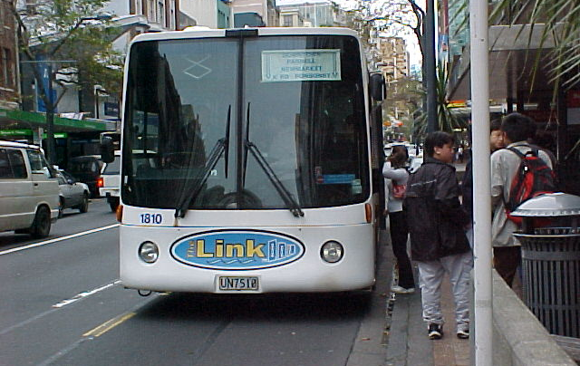
First universally accessible bus in Auckland
Now we need to train the bus drivers…...
Notes:
The introduction of a low floor fully accessible bus in the late 1990s resulted in far more older people using the bus service than before. They could park in the suburbs and take the bus into the CBD with ease. Previously, they did not feel confident to deal with the traffic in the CBD. Uptake of bus patronage improved considerably apparently, well over expectations.
Buses are steadily improving in their designs to better meet the needs of a diverse population.

Slide 17
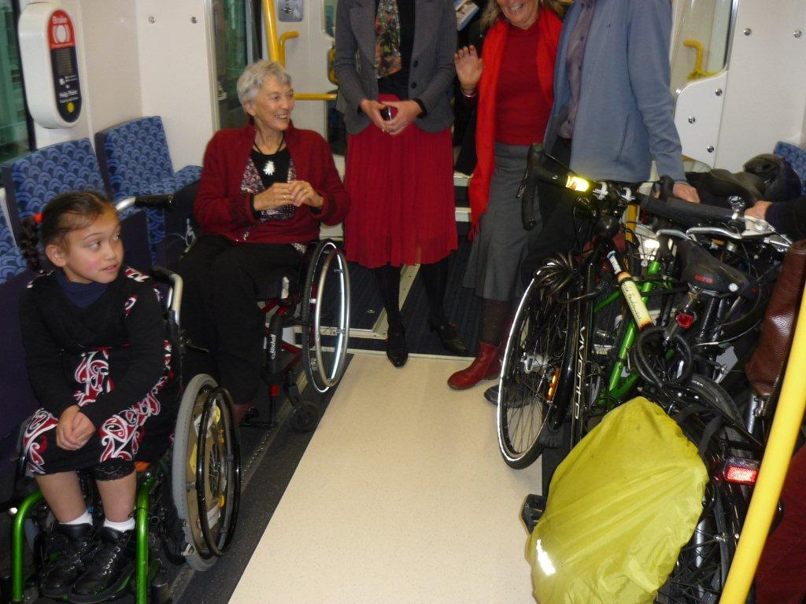
Public transport – Electric trains
Notes:
The electric units can easily accommodate a diverse range of passengers and their mobility equipment.
When the first EMU was officially unveiled 2013 it was found that the trailer carriage readily accommodated three bicycles and two wheelchairs in one designated area. Boarding the train is almost seamless.
Auckland Transport involved the disability sector in the design of the EMU trailer carriage from the very beginning, including sending three people to Wellington to view the Matangi train.

Slide 18
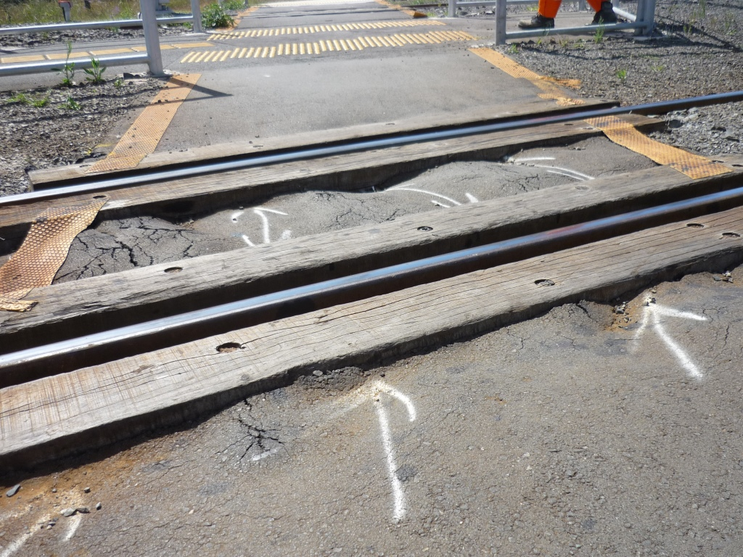
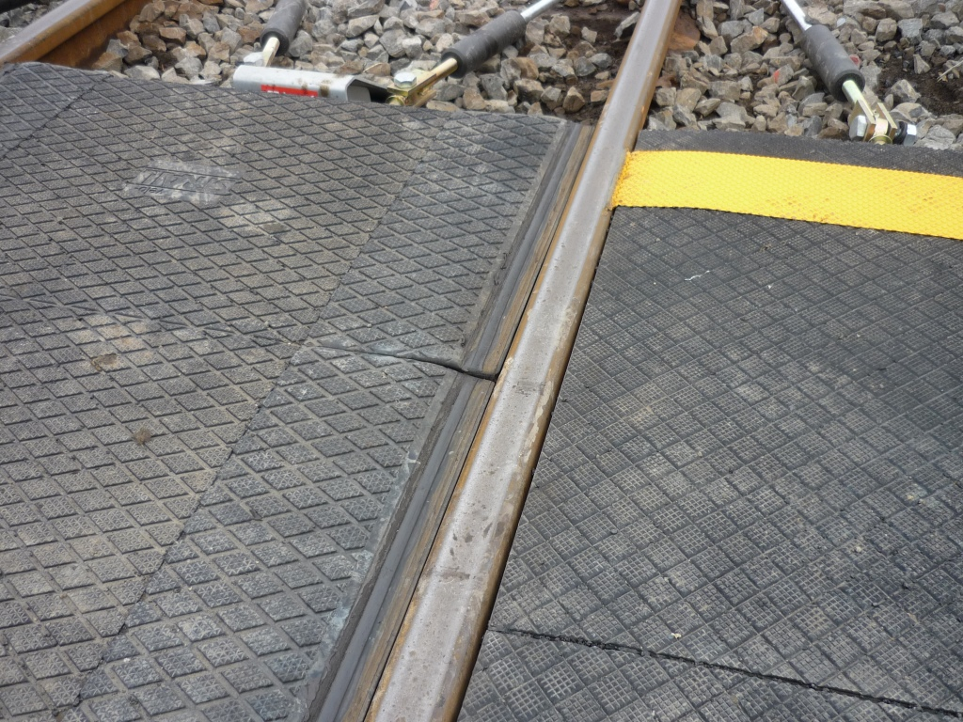
Working with KiwiRail
Notes:
Morningside Station – bad accident in 2013 when a power chair user’s small wheels (front casters) got trapped on the pedestrian crossing over the tracks and she was very badly injured when hit by the train. Now, after consultation with accessibility advisors, KiwiRail has changed the design of the interface between the rail and surrounding material to address the gap, so that small wheels can’t get caught.
Wonder why pedestrians had not called KiwiRail to report the poor quality of the crossing. Signage with telephone number was provided on the fence….

Slide 19
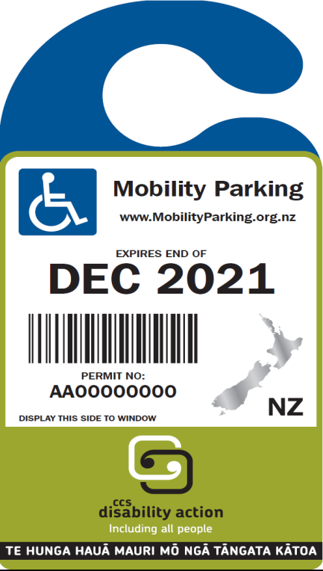
Impacts of current policy changes in the
built environment and streetscape design
Medium density housing
Dedicated bus lanes
Reduction in parking
Notes:
Some people will continue to be dependent on their cars, especially if they have stamina and/or mobility difficulties and cannot park within a reasonable distance from their destination.
Moves are in place to remove parking provision in medium and high density developments, especially if they are close to public transport.
If residents rely on a vehicle, where will they park them?
¾ of Mobility Parking Permit holders are over 65.

Slide 20
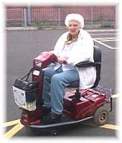
Shopmobility UK
Manual and power wheelchairs
Mobility scooters
Rollators (walking aids with seats)
Portable hearing loops
A service for both locals and tourists
Notes:
Solution in the UK for addressing congestion in city centres: - Shopmobility service.
People can drive to car parks on the outskirts of the city/town and take a free bus from there.
One of the car parks accommodates impaired people’s parking who can then hire suitable equipment for their needs. Mobility car parks located within 40 metres of the Shopmobility site
Free or small charge for hire of wheelchairs, scooters, power chairs
Can be hired for more than one day

Slide 21
Designing to overcome topography
Linkage buildings – horizontal & vertical links
and
Universal design into and through buildings

Slide 22
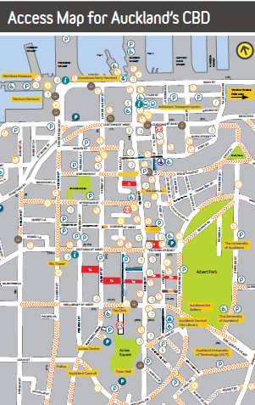
Linkage Buildings to overcome challenging topography
Notes:
This access map of the CBD shows linkage buildings in red, but you have to know Auckland pretty well to take advantage of them. Leaving Queen Street to reach Nelson Street to the West or heading East to the Art Gallery via buildings is possible but aren’t ‘official’ routes. There usually aren’t convenient bus routes to help overcome this topographically challenging area.
c/f In Wellington, the James Cook Hotel provides a perfect 24/7 vertical linkage between Lambton Quay and The Terrace.
Linkage buildings are great for those with mobility and/or stamina difficulties and give relief from the rain. It is a challenge to hold an umbrella when pushing a wheelchair or using a walking aid.

Slide 23
Access Matters Aotearoa
Kōrero for Change on Transport
https://www.accessmatters.org.nz/transport
Date: Wednesday, 9 October 2024
Time: 9am to 12pm
Where: via Zoom
Notes:
Access Matters Aotearoa has been running a very successful series of webinars on different topics which almost 300 people have participated in so far. An international speaker (USA) has been included in this event

